Slide 1
The plant catalogue

Slide 2
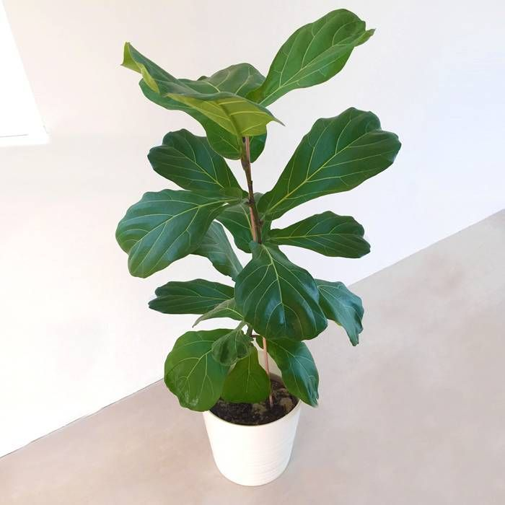




The plant catalogue
newCard
newDivPlantName
Fiddle-leaf fig
Chara
Characteristics
CharaH5
CharaSection
plantSizeValue
1,5
plantSizeIcon
Ficus Lyrata
plantSize
Characteristics
Maintenance

Slide 3

Nunito
Nunito
DM Serif Display
Characteristics
Roboto Adult Size: 1,3m inside, but can reach xx in the wild
Toxicity: moderately toxic to cats and dogs
Maintenance
Water: regular but moderate, they love humidity!
Light: bright but not direct
Fun fact
they are strangling plants: they usually kill the host on which they are growing

